Slide 1
DFSMShsm Health Check
Overview Presentation
What It Is – and
What You Will Learn

Slide 2
Agenda
Mainframe Health Check
  What is the issue?
  What is the solution?
  What are the requirements?
  What tools will be used?
  What is the cost?
  What will be analyzed?
  Sample worksheet
  Sample charts
  Sample reports
  What will you learn?

Slide 3
What is the Issue?
What is the Issue?
  DFSMShsm and Storage is a complex environment which requires constant maintenance and actions. Problems, errors and growth, if left unchecked start to act like viruses, affecting and causing unexplained increase in critical system resource usage, unexplained growth, thus increasing the risk of data inaccessibility or data loss.
    Many shops have based their storage procedures based upon business needs 15+ years ago, these procedures have never been totally reviewed and realigned or updated.
    Many shops purchase additional hardware thinking this solution will resolve the problems.
Adding hardware provides only temporary relief of the actual cause, and does not address CPU impacts from aging storage procedures.
Why do the DFSMShsm HealthCheck?
  If you have issues we can help you correct them and improve your efficiency
  If your DFSMShsm environment is in good shape, this analysis will confirm it and let you focus your energies elsewhere!

Slide 4
What is the Solution
HSM Health Check
  Trained technical staff will go on-site, collecting key critical data for performing an analysis of a customer’s storage environment.
    A health check will point out where hardware is being wasted.
    A health check will point out where software is being wasted.
    A health check will help you understand the overall health of your storage environment.
A health check can help reduce your spending, on CPU, DASD, and Tape and by doing so can even help you reduce energy consumption.

Slide 5
Are You a Candidate?
Who can Take Advantage of a Health Check?
  All mainframe installations
    No size requirements
        Large
        Medium
        Small
    Any site running DFSMShsm
        Large
        Medium
        Small
    Any site with mainframe storage
      Physical Tape
      Virtual Tape
      DASD
        Large
        Medium
        Small

Slide 6
Customer Requirements
The following software will need to be installed.
  IBM Tivoli Advanced Audit for DFSMShsm
    For Auditing all DFSMShsm Control Data Sets and HSM owned tapes
      Files Accessed –
        Migration Control Data Set, Backup Control Data Set, Offline Control Data Set, Tape Management Database
  IBM Tivoli Advanced Reporting for DFSMShsm
    For reporting of all HSM activity both current and historical
      Files Accessed
        Migration Control Data Set, Backup Control Data Set, DFSMShsm LOGy and LOGx Data Sets.
    OR – May install the new HSM HealthCheck Utility, a standalone utility that captures the relevant information with a simpler installation.

Slide 7
Any Other Requirements?
What Other Actions or Requirements will be needed of the Customer?
Absolutely Nothing –
  No other work or resource allocation will be required of the customer or their resources.
  All data collection will be completed by the assigned Technician to the project.
  All data collected is kept strictly confidential.

Slide 8
What Other Information Will Help
To Assist with Accurate Reporting and Numbers –
  Hardware –
    DASD -
      Total size of shop
      Total number of DASD boxes
      DASD manufacturer and model
    Tape –
      Type of hardware
        Physical
        Virtual
      Total hardware available
      Manufacturer and model
    Software –
      Total shop MIPs
      Cost per MIP
      MIPs allocated to DFSMShsm

Slide 9
What Will Be Reported On
What data will we be interested in reporting on –
  DFSMShsm
    Overall CDS Health -
      Errors found and reported
      CDS historical reporting
        Old data, unreferenced data, data at risk
    HSM Tapes –
      In error
      Lost
    DFSMShsm Work –
      Scheduled
      Requested
      Successful
      Unsuccessful

Slide 10
What Will Be Reported On (continued)
What data will we be interested in reporting on (continued) –
  DASD Storage
    Overall Storage Health –
      Volume Level
        Over allocated volumes
        Under allocated volumes
      Pool Level
        Over-allocated pools
        Under-allocated pools
      Data Set Level
        Over allocated data sets
        Under allocated data sets
        Incorrectly defined data sets
        Data sets at risk
    Reduce or free-up hardware
      Help reduce costs and reduce your Carbon Footprint

Slide 11
What Is The Cost?
There Is No Cost -
This Is A Free Analysis –

Slide 12
Report Samples

Slide 13
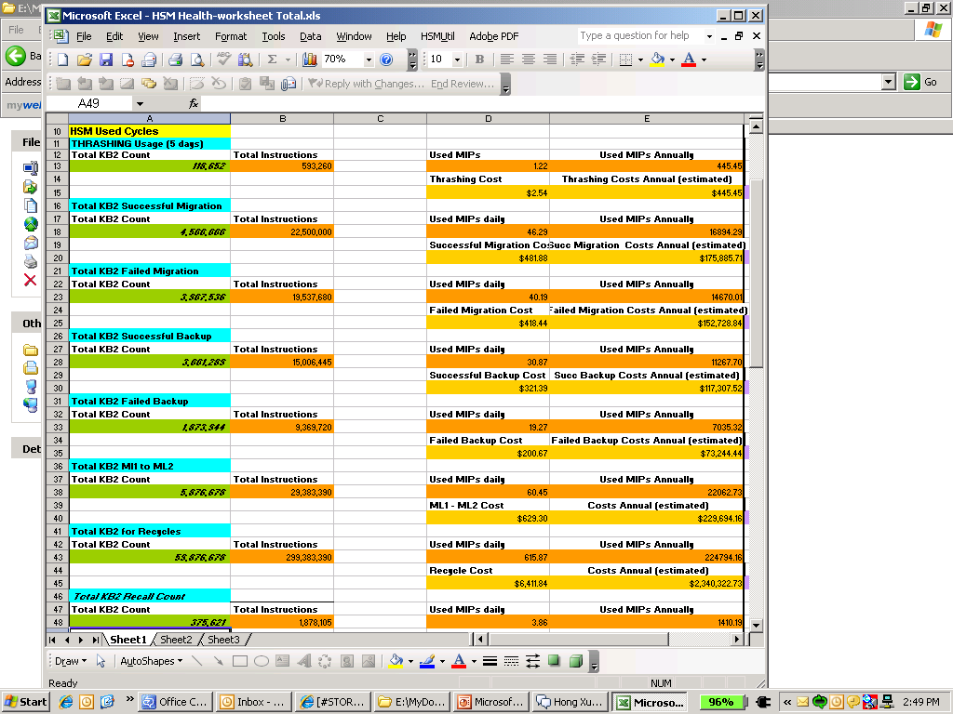
Report Sample – HSM Work
Title of Reported Area
  Blue
The Total KB2 Used
  Green
Total Instructions Needed for Action
  Orange
Total MIPs used for Action
  Orange
Estimated Cost for Action
  Light Brown

Slide 14
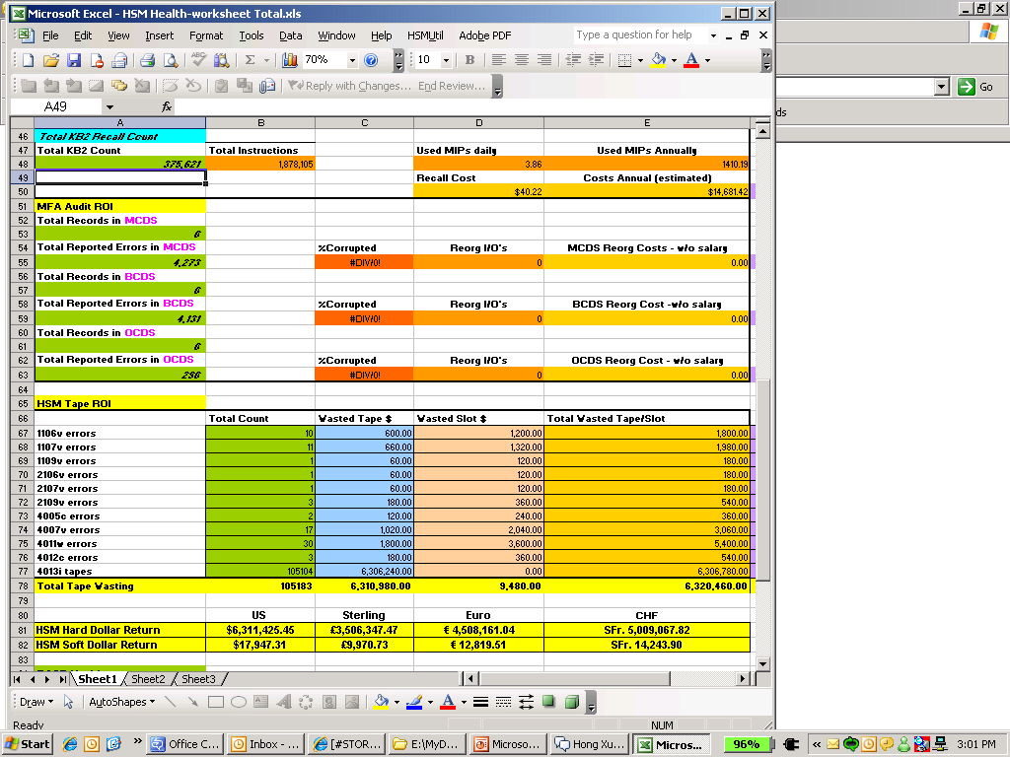
Report Sample – CDS & HSM Tape
Total Records in MCDS
  Total Errors
  Percentages
  Total Cost Per Reorg
Total Tape Errors
  Immediate Costs/Savings
  Soft Costs/Savings
Total Hard Dollar Costs
Total Soft Dollar Costs

Slide 15
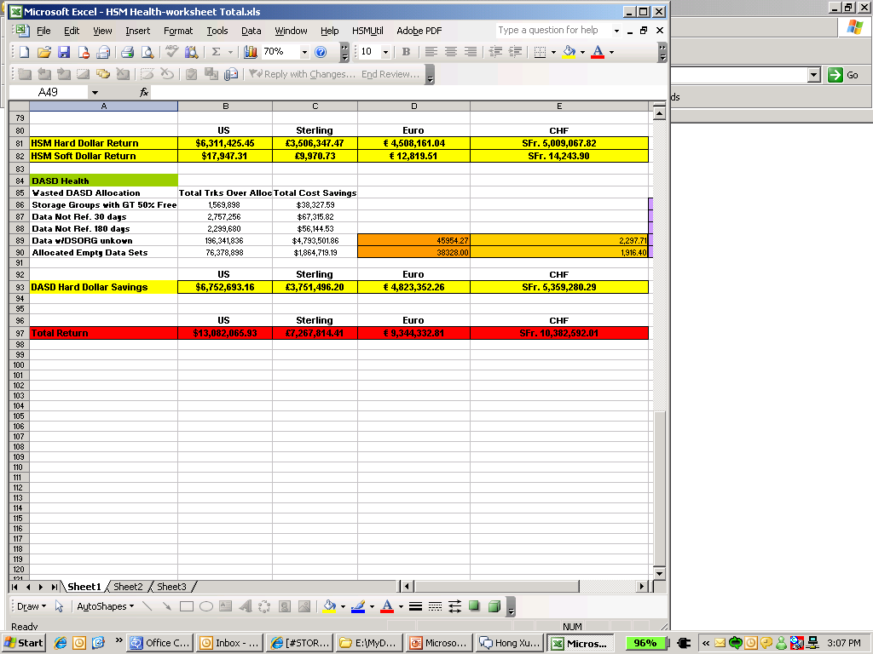
Report Sample – DASD & Totals
DASD Storage Savings
Tracks Over-Allocated
Cost Savings
Hard Dollar Savings
Total HARD DOLLAR Savings

Slide 16
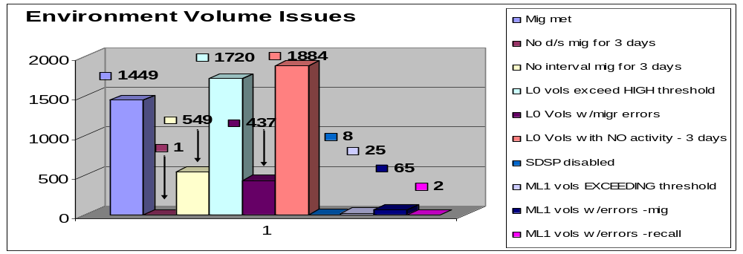
Customer Report Sample
Environment Issues
  What Data Was –
    Successful
    Not run
    With Errors
    No Activity
    Exceeding Thresholds
Environment Volume Issues –
The environment issue graph provides a high-level understanding of problem areas and the number of volumes affected by these issues.

Slide 17
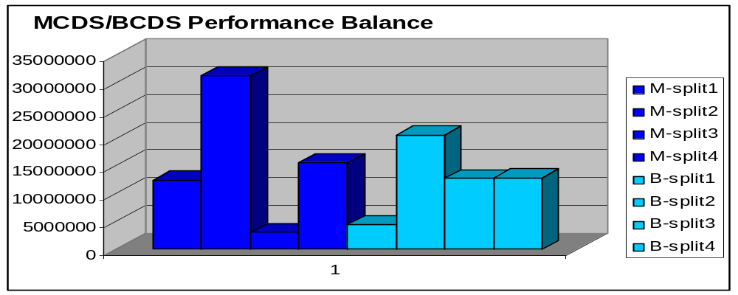
Customer Report Sample
CDS Splits
  CDS Performance and Balance
DFSMShsm Performance -
Both Company ABCs MCDS and BCDS Control Data Sets are at the maximum allowed splits supported by IBM and DFSMShsm. After careful analysis, it was determined the splits within the MCDS and BCDS need to be re-evaluated and redefined so that each split is better balanced. This can be done using the Mainstar CDS Expert Tool.

Slide 18
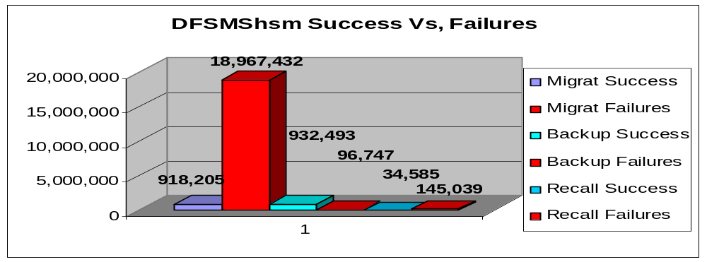
Customer Report Sample
DFSMShsm
  Success vs Failures
The first key area to understand are the RED bars, this represents unsuccessful actions tried by DFSMShsm. The most critical failure noted are the migration failures reported. There were over 20x more migration failures then migration success.

Slide 19
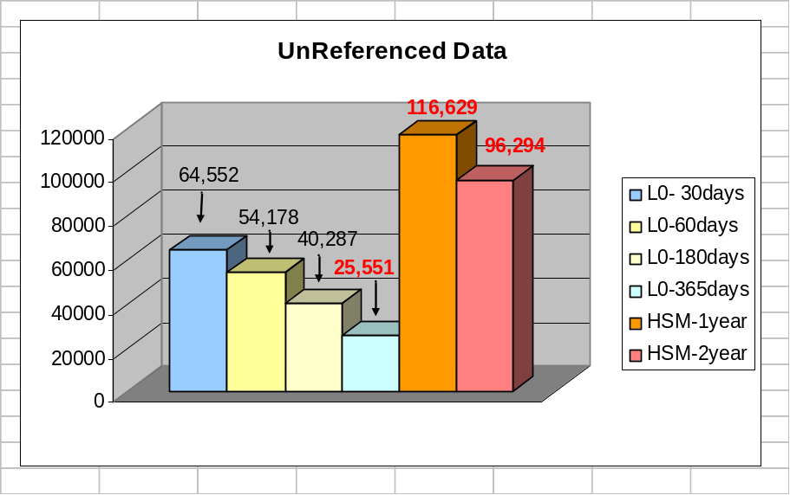
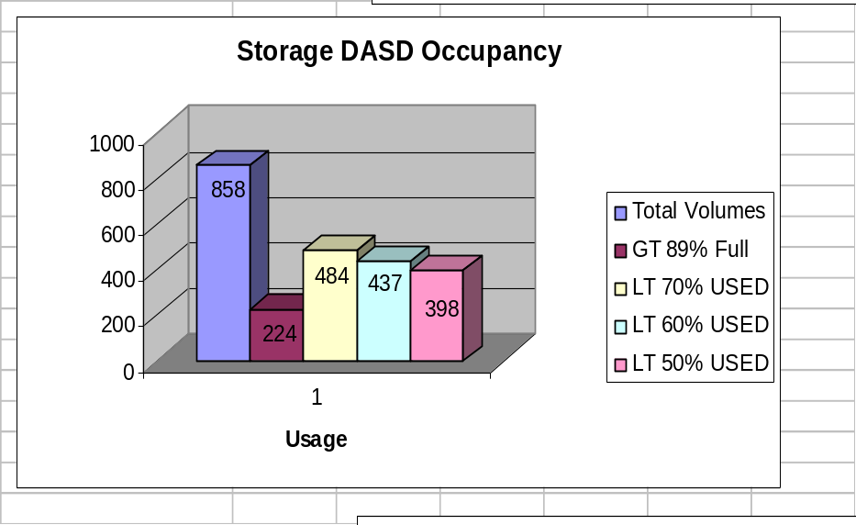
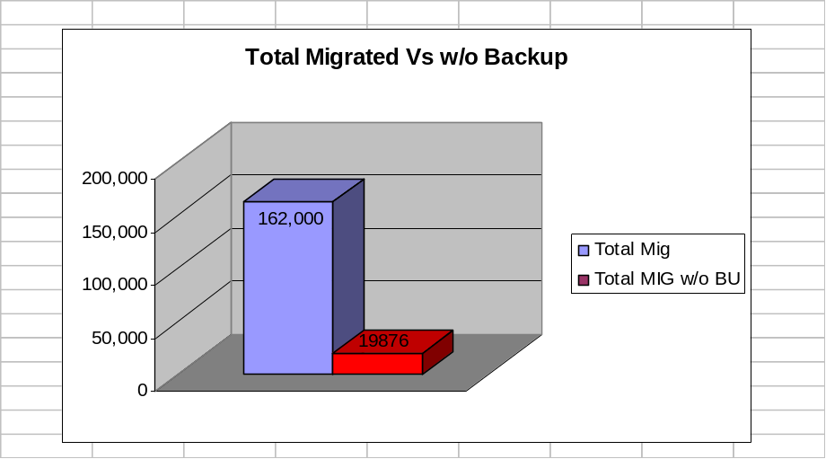
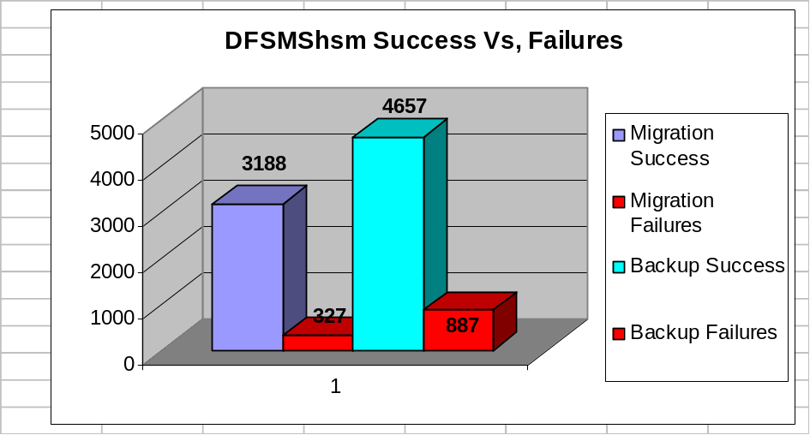
Customer Report Samples

Slide 20
Detailed Information Is Available
HSM BACKUP SUMMARY
FOR ALLVOL
S RC COUNT MESSAGE
00 932493 BACKUP OK
03 19 FMT 1 DSCB OBTAIN ERROR
07 11 FMT 3 DSCB OBTAIN ERROR
16 422 PRIMARY COPY READ ERROR
17 10293 PDS DIRECTORY READ ERROR
19 14159 DATA SET IN USE
24 8 MCDS RECORD UPDATE FAILURE
51 1 DATA SET IN USE BY DFHSM
56 34 VSAM BACKUP ERROR
58 2426 BACKUP FAILED FOR DSN
68 36197 BKUP FAILED - DFDSS ERROR
70 20315 SMS DS ERROR
74 1 BACKUP HELD
99 49058 UNSUPPORTED DS
HSM RECALL SUMMARY
FOR ALLVOL
S RC COUNT MESSAGE
00 34585 RECALL:RECOVERY OK
02 30387 DS NOT MIGRATED
04 11 NO PRI VOL AVAILABLE
15 219 VSAM NON BASE DELETE
35 2 INPUT OPEN ERROR
39 251 RACF PROCESSING ERROR
51 2779 OTHER FUNCTION USING DATA SET
69 14 RECALL:RECOVER FAILED, ERR IN DFDSS
70 29 SMS RELATED ERROR
74 101 RECALL:DELETE HELD
81 620 TAPE VOL ALLOC ERR
82 160 TAPE VOL NOT AVAIL
86 2 DFHSM SHUTDOWN AT TAPE WAIT
95 2 TAPE VOL MOUNT FAILURE
98 110462 UNKNOWN ERROR TYPE
HSM MIGRATE SUMMARY
FOR ALLVOL
RC COUNT MESSAGE
00 918205 MIGRATION OK
05 4187 NO MIGRATION VOLUME AVAILABLE
06 8869 DUPLICATE DSN IN MCDS
07 1345 FMT 3 DSCB OBTAIN ERROR
08 4201 MIG COPY ALLOCATION ERROR
14 1152 DS SCRATCH ERROR
16 6 PRIMARY COPY READ ERROR
17 77 PDS DIRECTORY READ ERROR
19 27173 DATA SET IN USE
21 1 DEVICE TYPE ERROR
24 20 DATA SET NOT AVAIL FOR MIGRAT
30 2429 DATA SET NOT CATALOGED
37 27389 NO SPACE ON MIG VOL
39 3 RACF PROCESSING ERROR
45 27 DATA SET NOT ELIGIBLE
51 1 DATA SET IN USE BY DFHSM
53 808753 EXPIRE ERROR, NEEDS BKUP FIRST
58 1797 MIGRATION OR DBA DBU FAILED
68 170 DFDSS ERROR
70 133875 SMS DS ERROR
71 1 UNKNOWN ERROR TYPE
80 585 DS BACKUP REQUIRED
82 87 TAPE MIGRATION UNSUPPORTED
99 854153 UNSUPPORTED DS

Slide 21
What We Will Learn
What information is generated during the analysis?
  Once the analysis is completed a multi-page report is made available to the customer detailing the findings with supporting graphs and technical evaluation. The report will also include costs and savings, these numbers are based upon a generic industry hardware and software estimates unless tailored with customer-specific information.
  The final report can be reviewed with the customer by the Account Manager, Technical Engineer or Manager of the Health Analysis Team. All customer questions will be discussed, answered and agreed upon.

Slide 22
What We Will Learn (continued)
What information will you learn from the analysis?
  Customers should have a good understanding of the following
    Storage
      What immediate estimated hard dollar savings they can expect by better management of hardware
        DASD hardware
        Tape
      What immediate estimated soft dollar savings they can expect by better management of hardware
        DASD hardware resource maintenance
        Tape resource maintenance
    CPU Usage
      An estimate of costs for DFSMShsm work
        Successful/Unsuccessful
    Overall Control Data Health
      An understanding of the Errors Vs Healthy HSM controlled data

Slide 23


Slide 24
Health Check
Overview Presentation
What It Is –
What You Will Understand -
Steven Clar
Product Manager / Product Marketing Manager
sclar@rs.com

